Slide 1











EKANS
191180005 – Selin Cansu Akbaş
191180006 – Mert Akgüç
191180009 – Furkan Onur Akman

Slide 2

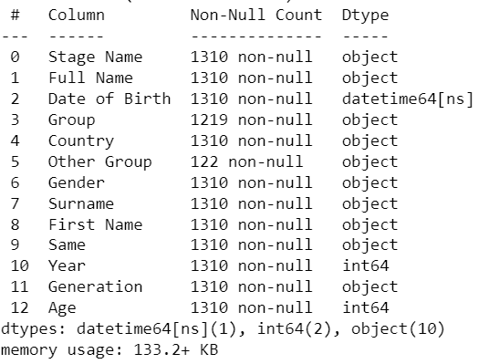
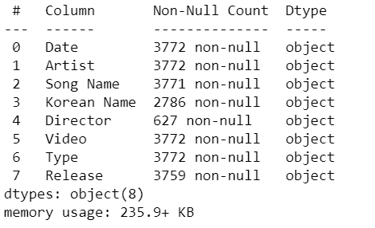
K-Pop Dataset Infos
Idols
Youtube
Spotify

Slide 3


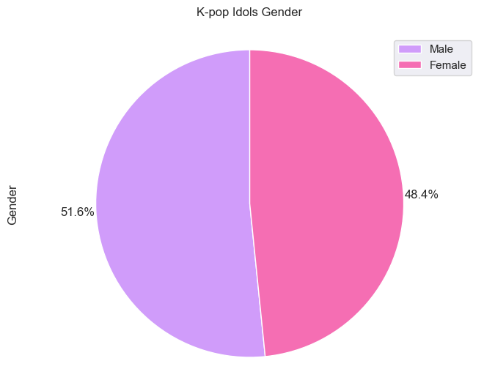
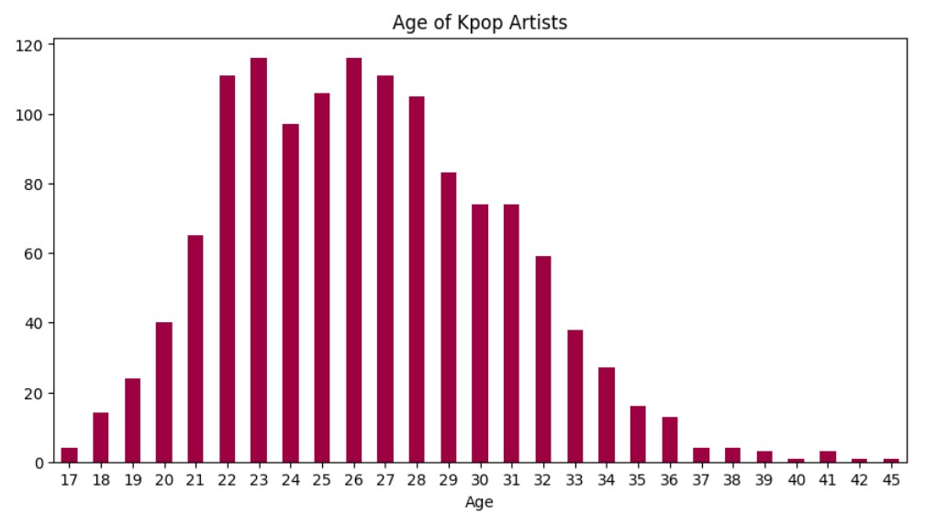
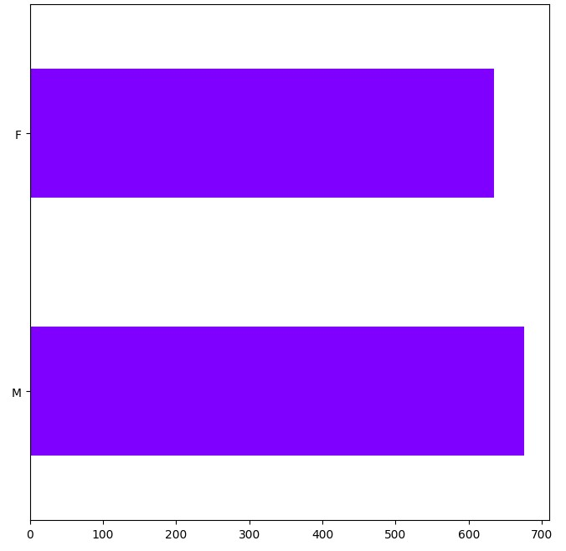
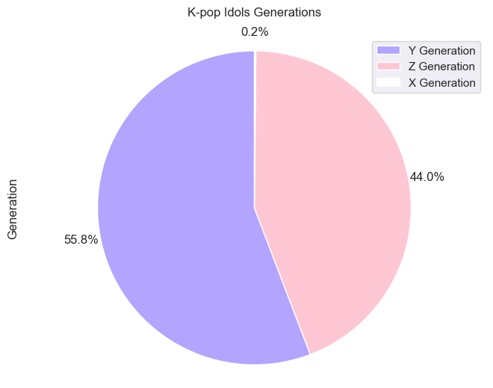

Gender
Analysis
Age
Analysis

Slide 4
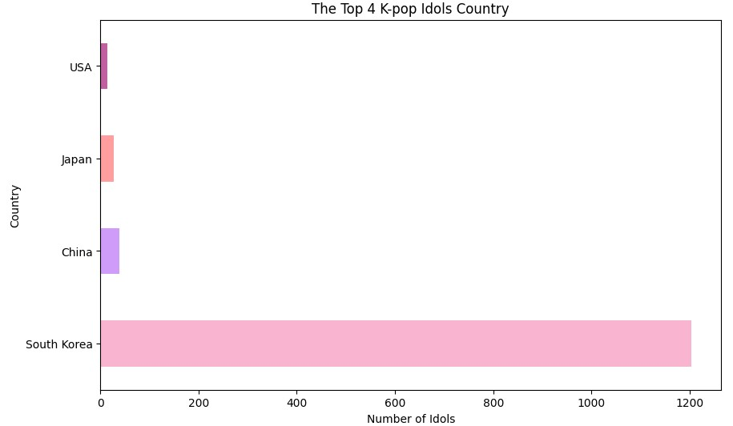
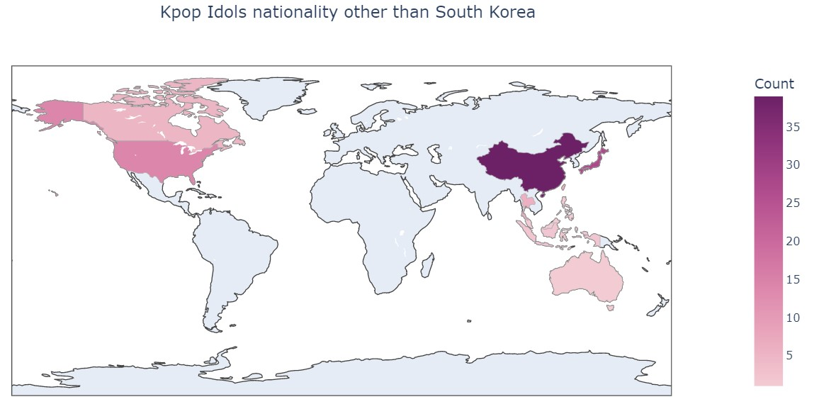
Foreign Idol Analysis
Kpop idols came from 12 different countries.

Slide 5

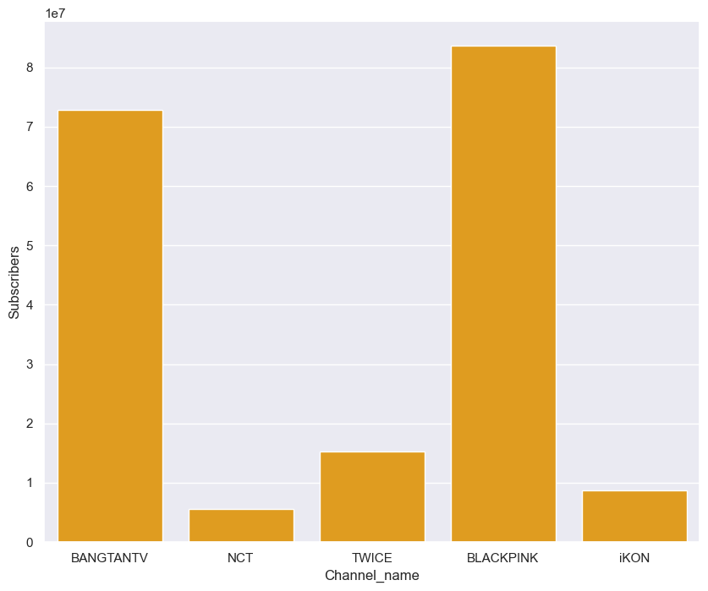
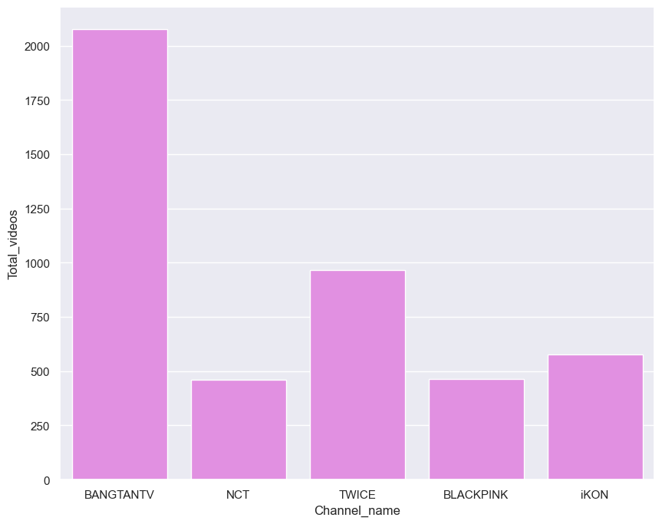
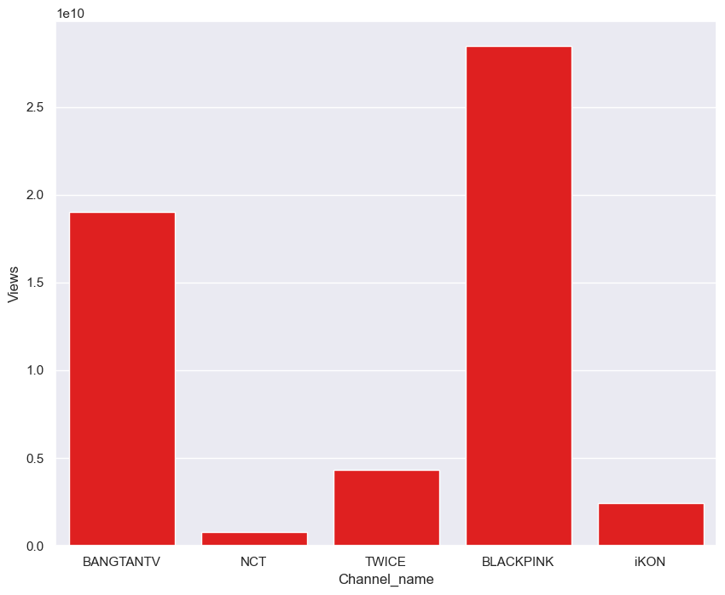
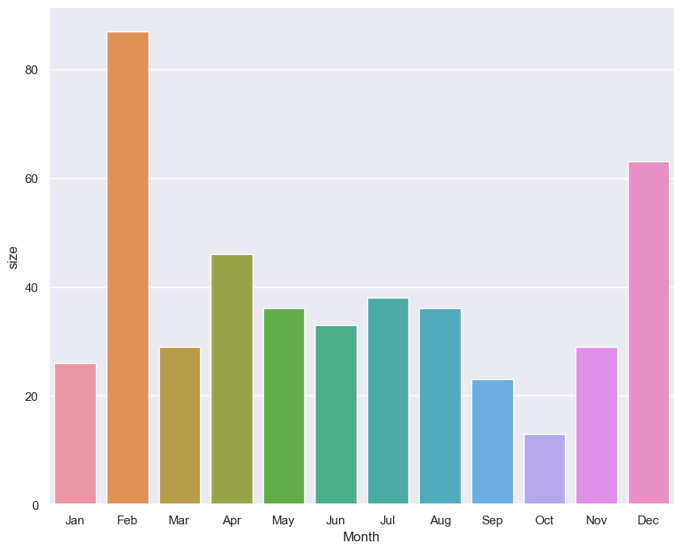
Youtube Analysis
Bangtantv is the group with the highest number of videos.
Blackpink is the group with the most subscribers.
February is the
month in which
the most videos are uploaded.
Blackpink is the group with the most views.

Slide 6
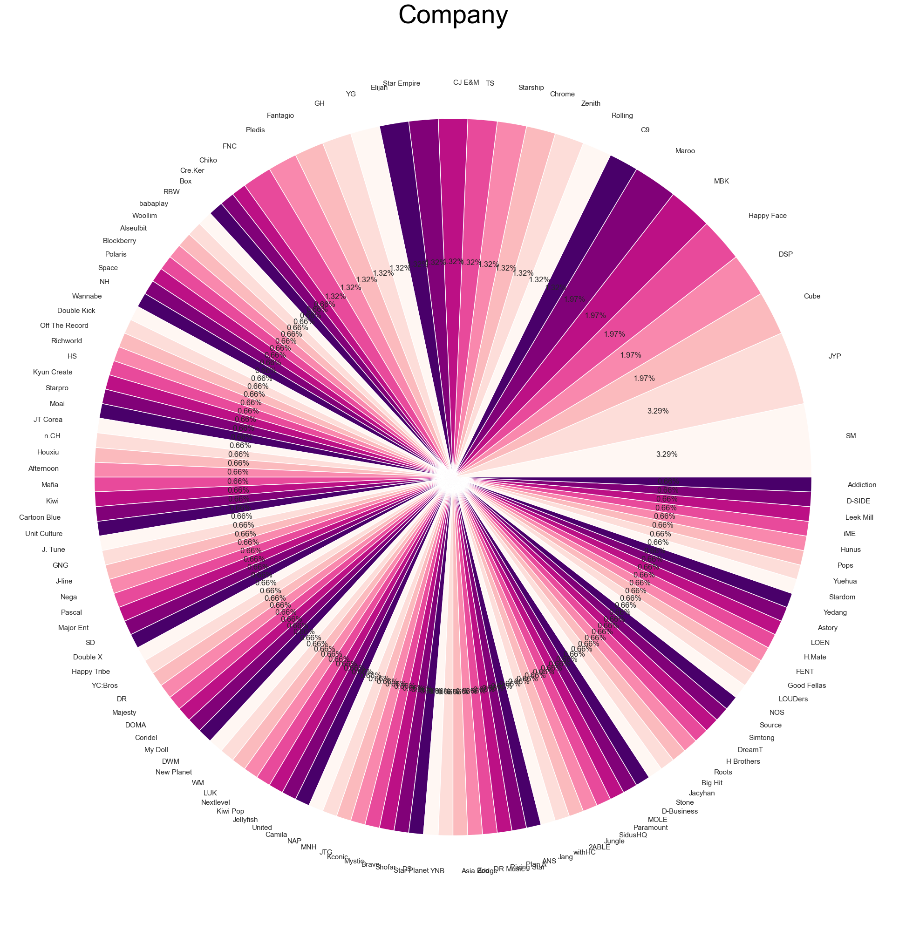
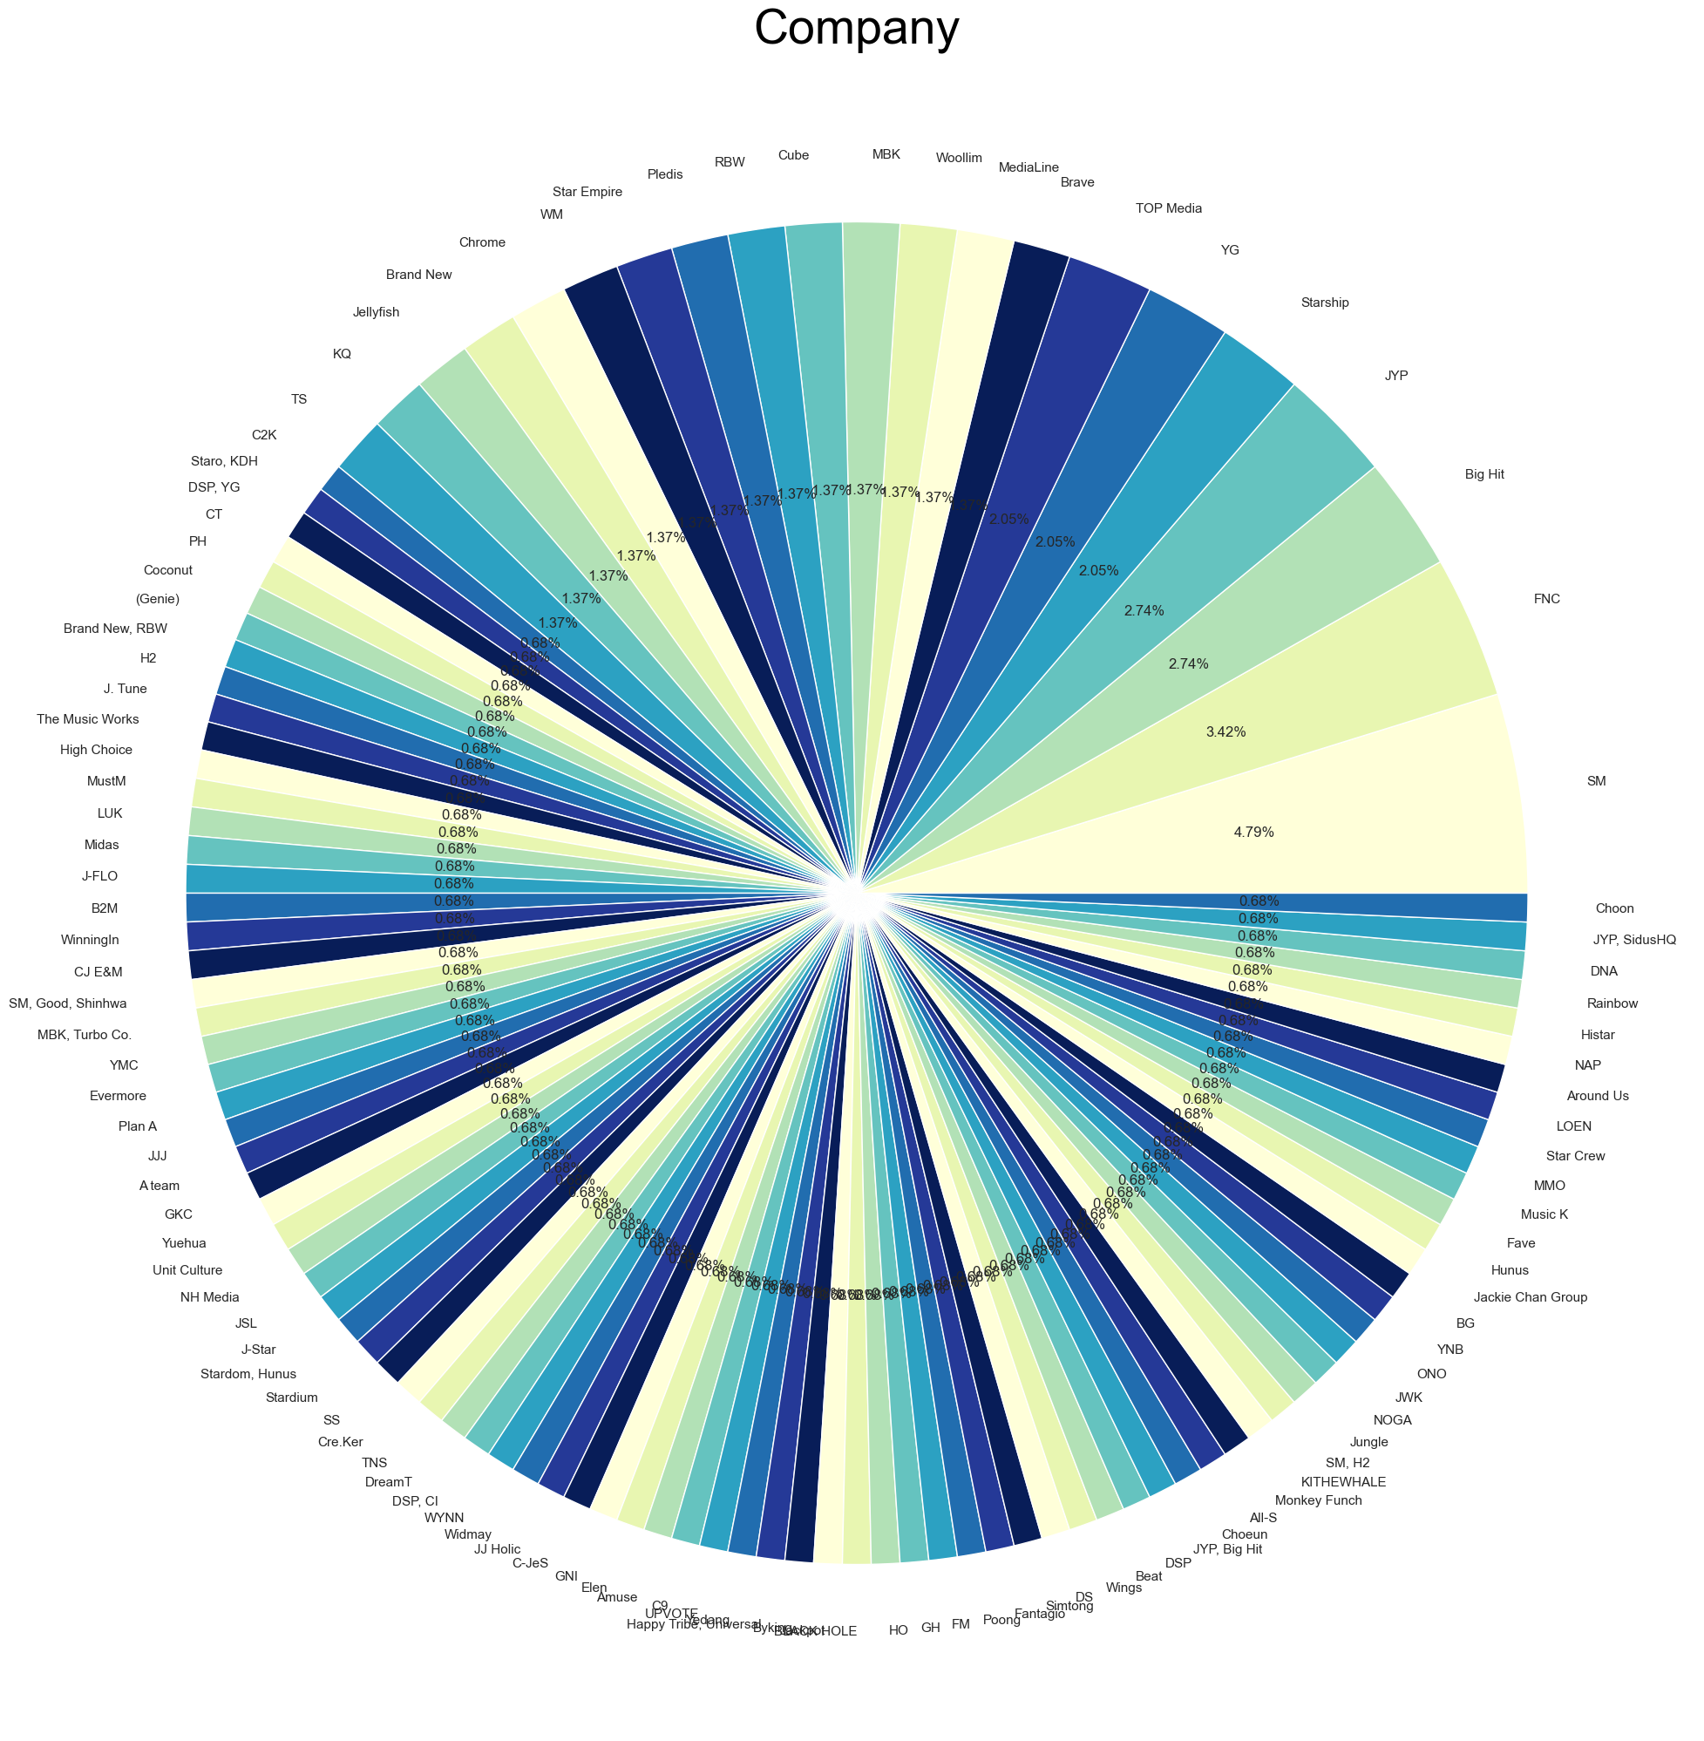
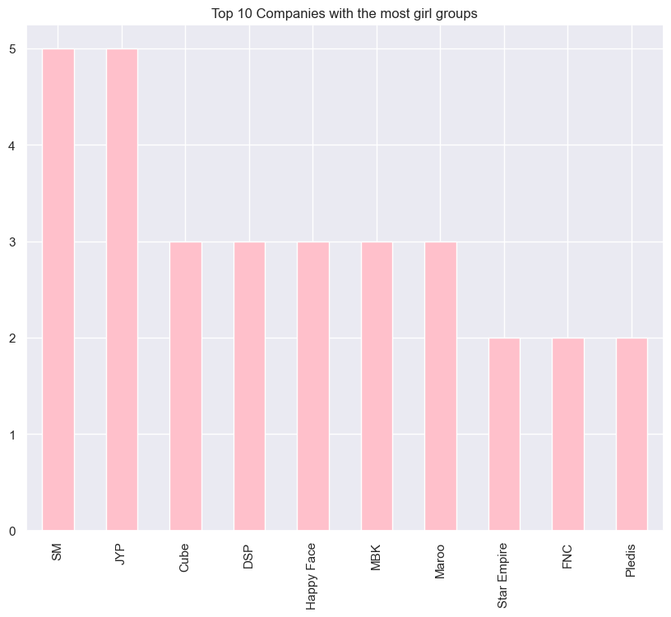
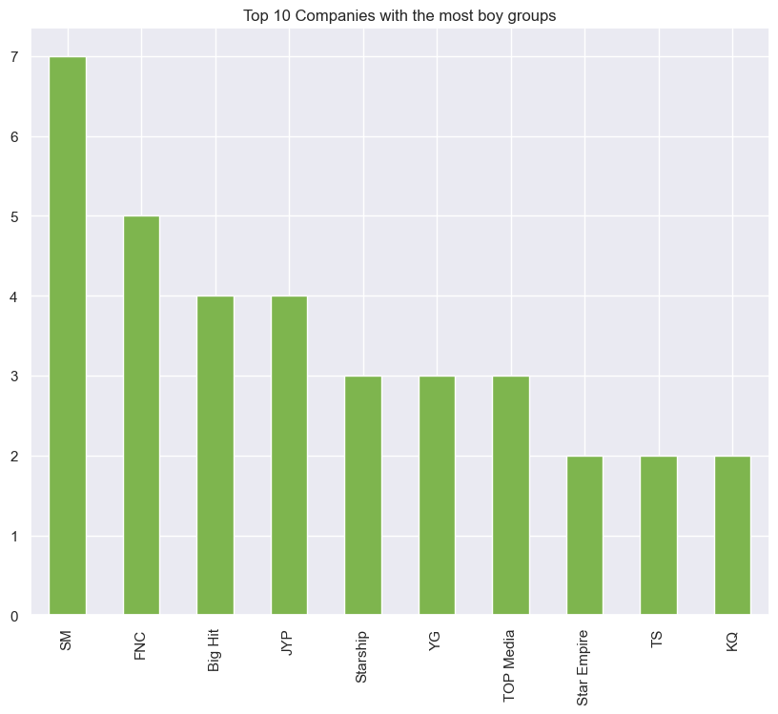
Company Analysis
Boy Groups
Girl Groups

Slide 7

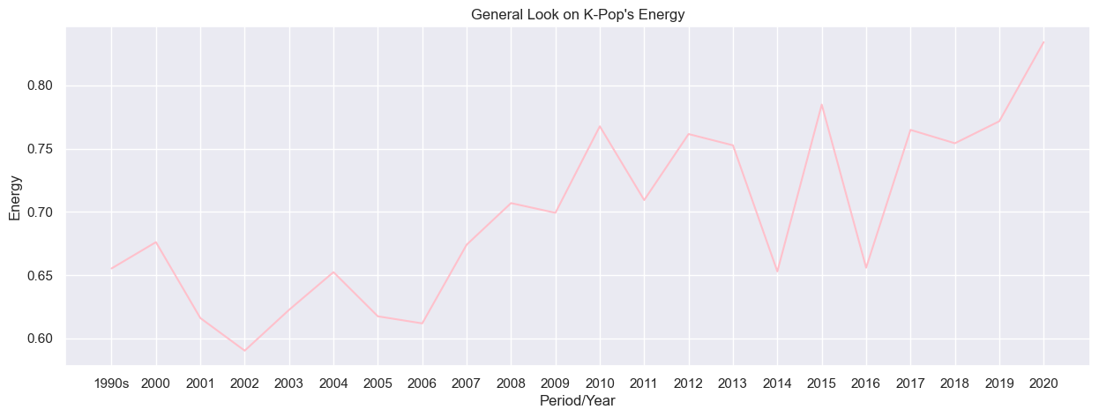
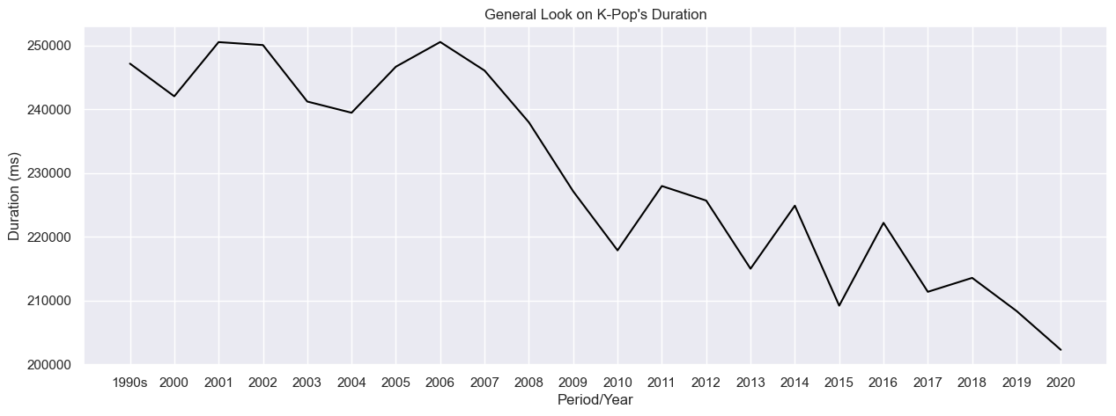
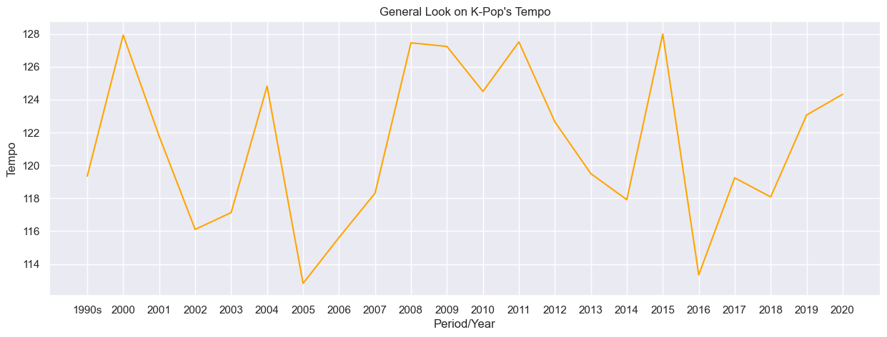
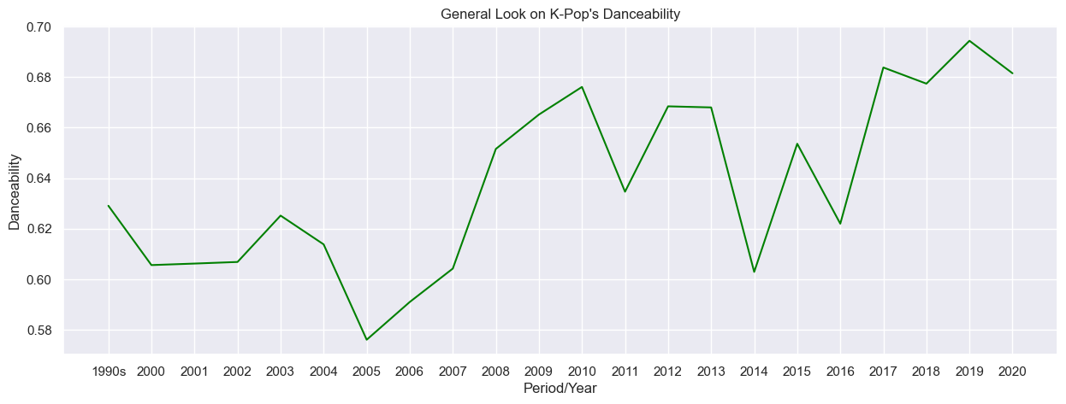
Spotify Analysis
Energy
Duration
Tempo
Danceability

Slide 8
Thank you!

